Slide 1
Applying solutions to Supply Chain programs Shanghai November 2013
Nick Boland
Director - Solutions Consulting

Slide 2
About Amber Road
Leading provider of Global Trade Management (GTM) software and information services since 1991.
Solutions for all participants in global trade
Importers
Exporters
Third Party Logistics Providers
Over 500+ enterprise customers worldwide
Users in more than 70 countries
~500 global trade professionals employees
US, Europe, China and India
Flexible deployment model
Notes:
About Amber Road:
We are the leading provider of Global Trade Management software and services.
We have solutions for all participants in global trade including importers, exporters and third party logistics providers. Our solutions help these players to move goods across international borders in the most efficient, compliant and profitable way.
We have over 500 enterprise class customers around the world, with users in 70 countries.
We also have over 450 employees, spread across the U.S., Europe and India.
Finally, we support a very flexible deployment model. Our solutions can either be delivered in the cloud, or installed behind your firewall.

Slide 3
Global Customer Base – Many Verticals
High-Tech / Electronics
Retail / Apparel
Industrial
Chemical / Pharma
Oil & Gas
Logistics
Food & Beverage
Notes:
3
As you can see, we have a very strong list of customers who have operations all over the world. Since global trade isn’t limited to certain industries, we have customers in every major vertical.

Slide 4
Todays discussion
The challenges
Increase in Supply Chain security programs globally
Greater complexity = greater risk = greater scrutiny.
Greater risk of audit means increased administration effort
Other compliance programs such as financial sanctions, trade compliance
Greater operational cost
Expected by Customers

Slide 5
Some statistics

Slide 6
Consistent factors in Supply chain security
Know the partners on your supply chain.
Document processes in accordance with the required program standard
Maintain audit records / visits
Have corrective action plans established
Train staff / partners
Maintain / change control processes

Slide 7
Key attributes technology needs to deliver
Ability to handle multiple programs
Multi-lingual capabilities
Secure access and control
Screening for Partners
Screening for transactions / products
Audit / reporting capability
Alert and escalation management
Easy to use / manage / share
Scalable and flexible

Slide 8
Core steps to success
Manage the program – Content
Manage Master data – Partners / Products
Manage Transactions
Manage audit and reporting

Slide 9
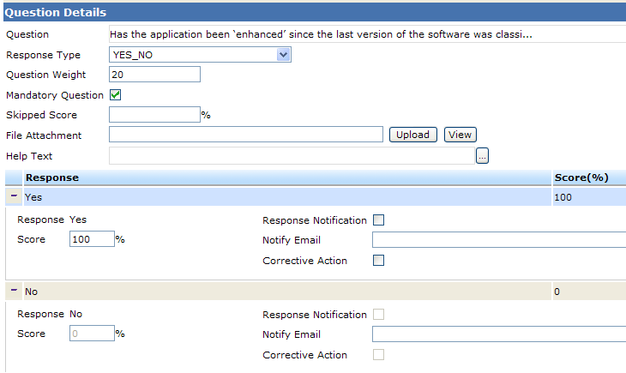
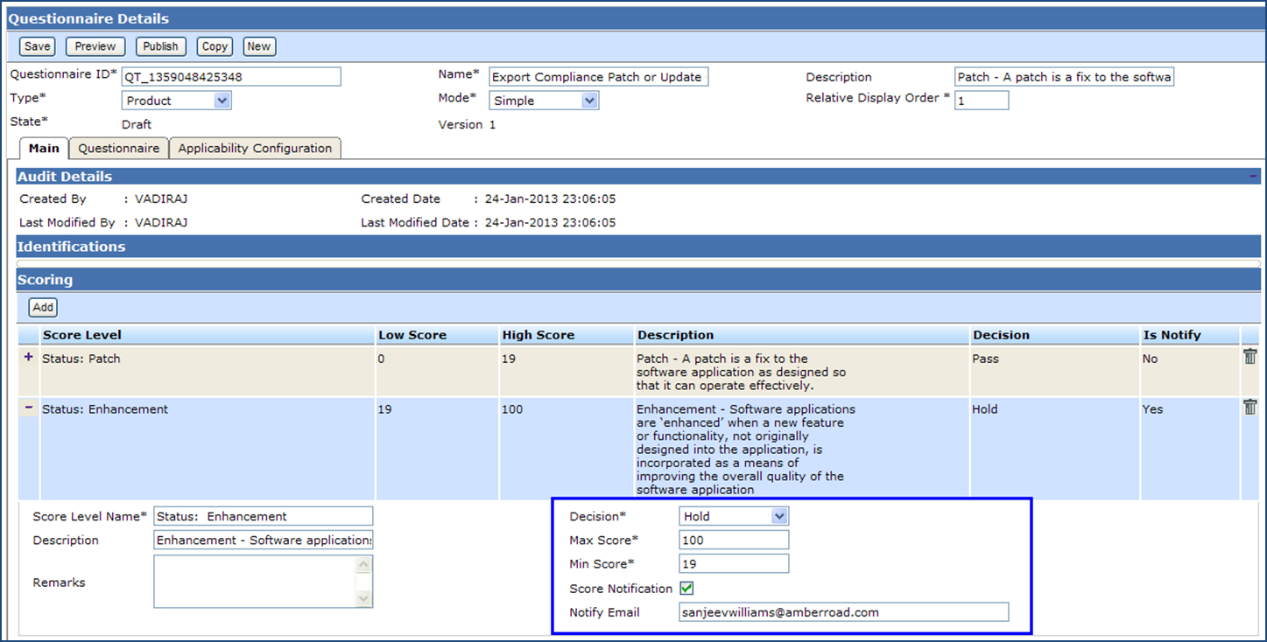
Technology in action – Program management

Slide 10
Technology in action - Knowing the Partners ..
Partner typically include Suppliers, intermediaries and logistics providers.
Other compliance initiatives would include such examples as:
Banks
Agents
Staff / Contract staff

Slide 11
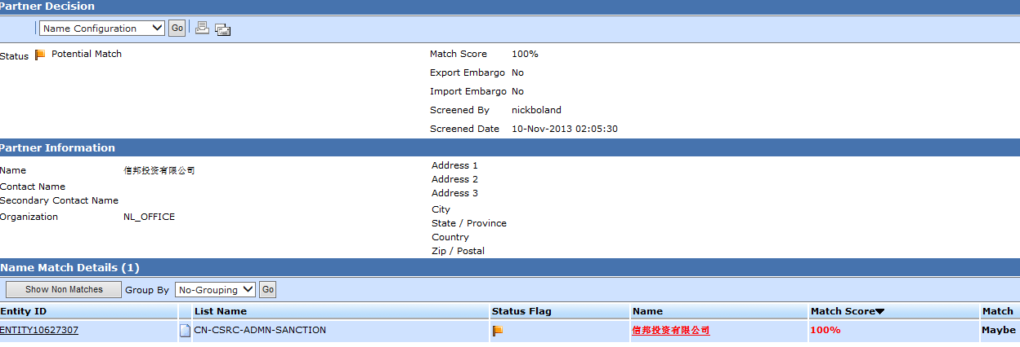
Screening - partners
Know your partners …
Historic focus on US and EU lists
At least 23 Countries have restricted party lists today – inc: CN, JP, IN, SG, MY

Slide 12
In practice – ongoing transaction validation
Solutions can identify key factors against validation frameworks:
Are these Partners approved ?
Are they operating in accordance with our expectations ?
Are these products we buy / sell ?
Validated HS codes
Other classifications
Is there anything unusual regarding these transactions ?
Are there additional Trade Compliance factors that may have changed:
Licences
Quotas
Sanctions…
Exceptions triggered ?

Slide 13
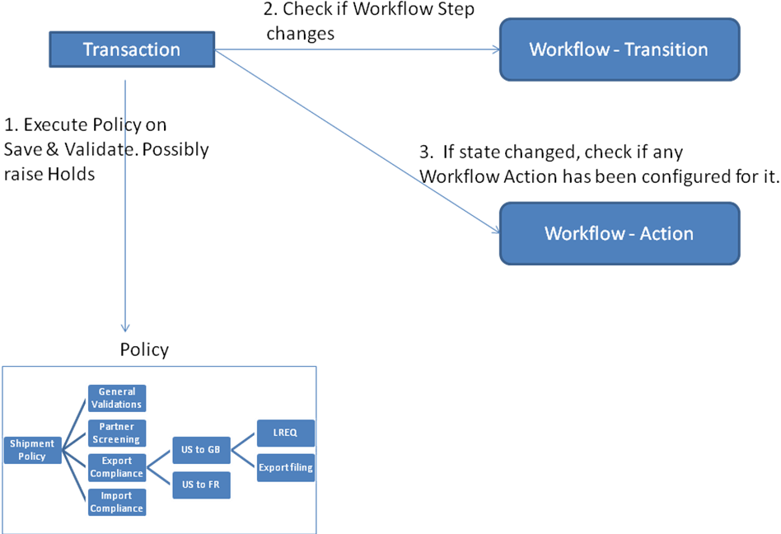
In practice – ongoing transaction validation

Slide 14
Transaction workflow validation

Slide 15
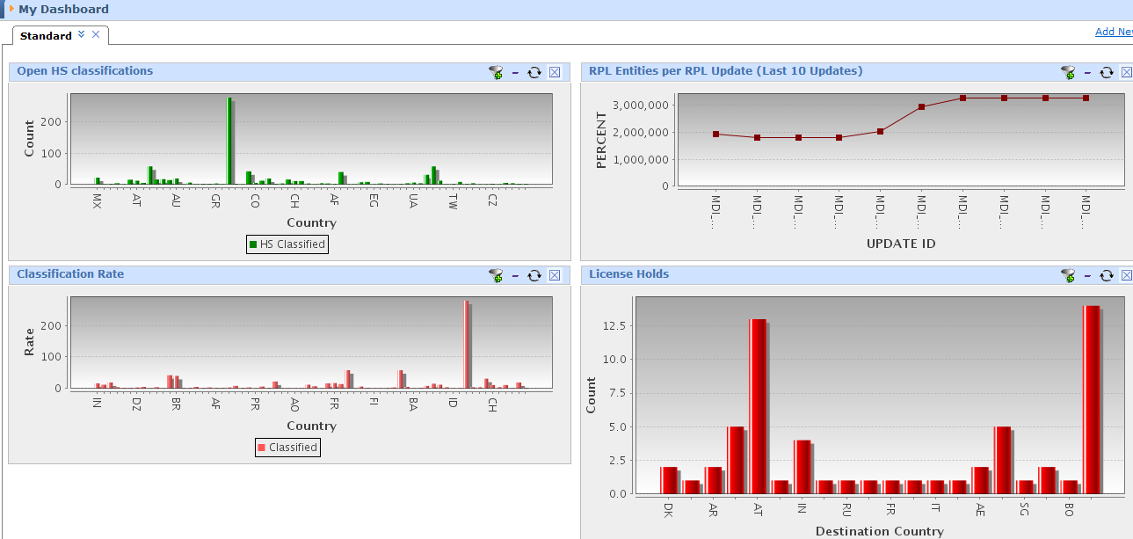
Audit / reporting / Alerts
On screen Portals
Reporting tools – auto create / distribute
Alert emails

Slide 16
Summary
Software and content can be valuable assets in Trade and Security compliance programs.
Clear benefits in maintaining compliance
Enterprises should think of Supply Chain security as part of their overall Compliance program.
Increased enforcement is raising the profile of compliance – its time to act ….

