Slide 1
CBFANC Seminar April 18, 2018 Fundamentals of Customs Valuation: First Sale
by
George R. Tuttle, III
George R. Tuttle Law Offices
Phone (415) 288-0428
mobile: (415)254-5986
E-mail: geo@tuttlelaw.com

Slide 2
Use of the “First Sale” For Customs Valuation
Nissho Iwai American Corporation vs. U.S., 982 F.2d 505 (1992)
Court held that Mfg selling price to middleman is an acceptable “TV” when:
There is a sale (I.e., transfer of ownership of the goods)
negotiated at arm's length, free from any non-market influences
goods are clearly destined for export to United States
Reaffirmed in Target Stores v. United States, 31 CIT 154, 157, 471 F. Supp. 2d 1344, 1347 (2007).
CBP Informed Compliance Publication: "Bona Fide Sales and Sales for Exportation."
(Drop-shipment)

Slide 3
“First Sale” For Customs Valuation
“Clearly destined for export to the United States”
Goods shipped directly to the United States. HQ 547382, February 14, 2002.
Purchase order and invoices specify the goods are for/destined to the U.S.
Manufacture, design, and other unique specifications or characteristics of the merchandise; labels, logos, stock numbers, or unique marks are in conformity with U.S. buyer's standards;
Marking, visas, warranties or other types of certification or characteristics required for entry or operation in the U.S.
Avoid simultaneous transfers of title or passage of risk of loss

Slide 4
“First Sale” For Customs Valuation
T.D. 96-87, Determining Transaction Value in Multi-Tiered Transactions, Vol. 30/31, Customs Bulletin No. 52/1 (January 2, 1997)
CBP presumes that transaction value is based on the price paid by the importer
Importer must request appraisement based on the price paid by the middleman to the foreign Manufacturer
Importer must present sufficient evidence that:
First sale was a bona fide "arm's length sale;" and
clearly destined for export to the United States at the time it was sold to the middleman.

Slide 5
Title and Transfer Issues
Simultaneous or flash transfer of Title
where the middleman and the buyer obtain title at virtually the same moment, as evidenced by both parties having the same terms of sale may cause CBP to more closely scrutinize a transaction.
By itself, flash transfer of title does not equate to a failure to show a bona fide sale (for instance, see HRL W563605, dated November 19, 2009)
but this factor along with who carries the risk of loss are considered by CBP in its determination of whether or not a bona fide sale has occurred.

Slide 6
Title and Transfer Issues
HRL H016966, dated December 17, 2007
"Whenever there is a purported series of sales, and the same terms of sale are used in both transactions, there is a concern that the middleman obtains risk of loss and title only momentarily or never at all, and thus has nothing to sell to the ultimate purchaser.”
“In such situations the middleman may be a buying or selling agent rather than an independent buyer/seller and the sale will be said to occur between the party identified as the first seller and the ultimate U.S. purchaser."
A determination of when title and risk of loss pass from the seller to the buyer in a particular transaction depends on whether the applicable contract is a "shipment" or "destination" contract. HQ H246429, January 7, 2014

Slide 7
Title and Transfer Issues
Title transfers
In a shipment contract, when Seller completes physical delivery to the carrier
Ex works
F-terms (FCA, FAS, FOB, etc.
C-terms (CIF, C & F, etc.)
In a destination contract, when goods are physically delivered to the location required
D-Terms (i.e., DDU and DDP)

Slide 8
Simultaneous or Flash Transfer of Title
Sale 1
Terms
“FCA Shenzhen”
Sale 2
Terms
“FCA Shenzhen”
MFG
Middleman
Importer
Middleman does not have “possession of goods”

Slide 9
Consecutive transfer of Title
Sale 2
Terms
“FCA Shenzhen” or “CIF San Francisco”
Sale 1
Terms
“EX Works-MFG”
MFG
Middleman
Importer
Middleman has “possession of the goods”

Slide 10
“First Sale” For Customs Valuation
information and Documentation Requirements
Importer must describe
Roles of all parties and furnish relevant documents pertaining to each transaction that was involved in the exportation of the merchandise to the United States.
Relevant documents include:
purchase orders, invoices, proof of payment, contracts and any additional documents (e.g. correspondence), demonstrating how the parties dealt with one another and which support the claim that the merchandise was clearly destined to the United States.
CBP looking for complete paper trail of the imported merchandise showing the structure of the entire transaction
HQ H246429, January 7, 2014

Slide 11
Transaction Value: First Sale Issues
Treasury Decision (T.D.) 96-87, dated January 2, 1997:
importer must provide a description of the roles of the parties involved and must supply relevant documentation addressing each transaction that was involved in the exportation of the merchandise to the United States.
The documents may include, but are not limited to purchase orders, invoices, proof of payments, contracts, and any additional documents that establishes how the parties deal with one another.
The objective is to provide CBP with "a complete paper trail of the imported merchandise showing the structure of the entire transaction."
Importer must also inform CBP of any statutory additions and their amounts.
If unable to do so, the sale between the middleman and the manufacturer cannot form the basis of transaction value.

Slide 12
Transaction Value: First Sale Issues
If the foreign manufacturer and the reseller are related, the sale will not be acceptable to CBP unless the intercompany sale transaction is a valid transaction value.
HQ H256779, January 20, 2016
HQ H255028, November 21, 2014:
. . . we note that an importer may request appraisement based on the price paid by the middleman to the foreign manufacturer in situations where the middleman is not the importer.
. . . it is the importer's responsibility … to show that the "first sale" price is acceptable under the standard set forth in Nissho Iwai. That is, the importer must present sufficient evidence that the alleged sale was a bona fide "arm's length sale," and that it was "a sale for export to the United States" within the meaning of 19 U.S.C. 1401a.

Slide 13
Transaction Value: First Sale Issues
Incoterms: Risk of loss and the simultaneous (back-to-back) transfer of title
Middleman should possess merchandise or risk of loss:
In HQ H016966, dated December 17, 2007, CBP stated that:
"Whenever there is a purported series of sales, and the same terms of sale are used in both transactions, there is a concern that the middleman obtains risk of loss and title only momentarily or never at all, and thus has nothing to sell to the ultimate purchaser.
… the use of identical terms of sale suggested that there was only one sale. Based on that and other factors, CBP concluded that there was not a bona fide sale between the manufacturer and the middleman.
See HQ H236428, September 8, 2014; HQ 546192, February 23, 1996
HQ H272113, March 9, 2016 – rejects "First Sale" appraisement of merchandise
HQ H224598, December 30, 2014– accepts First Sale" appraisement of merchandise

Slide 14
Simultaneous Transfer of Title
By itself, simultaneous or flash transfer of title does not equate to failure to show a bona fide sale. However, it may cause CBP to more closely scrutinize a transaction
In determining whether a bona fide sale occurs, Customs will consider other pertinent evidence or documentation if made available. Specifically, Customs considers as evidence of a buyer-seller relationship whether the “middleman”:
a. provided (or could provide) instructions to the seller;
b. was free to sell the items at any price he or she desired;
c. selected (or could select) his or her own customers without consulting the seller; and
d. could order the imported merchandise and have it delivered for his or her own inventory

Slide 15
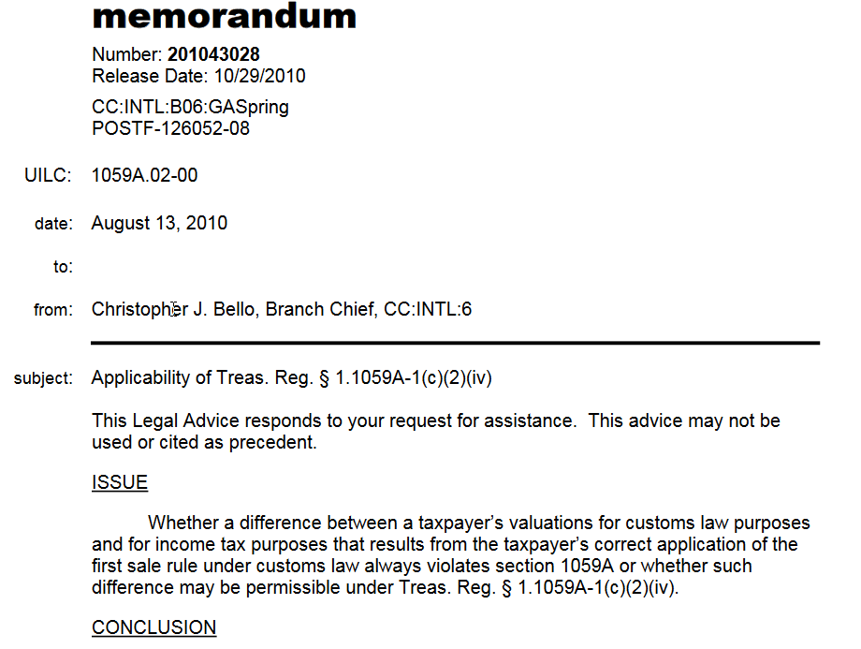
https://www.irs.gov/pub/irs-wd/1043028.pdf

