Slide 1
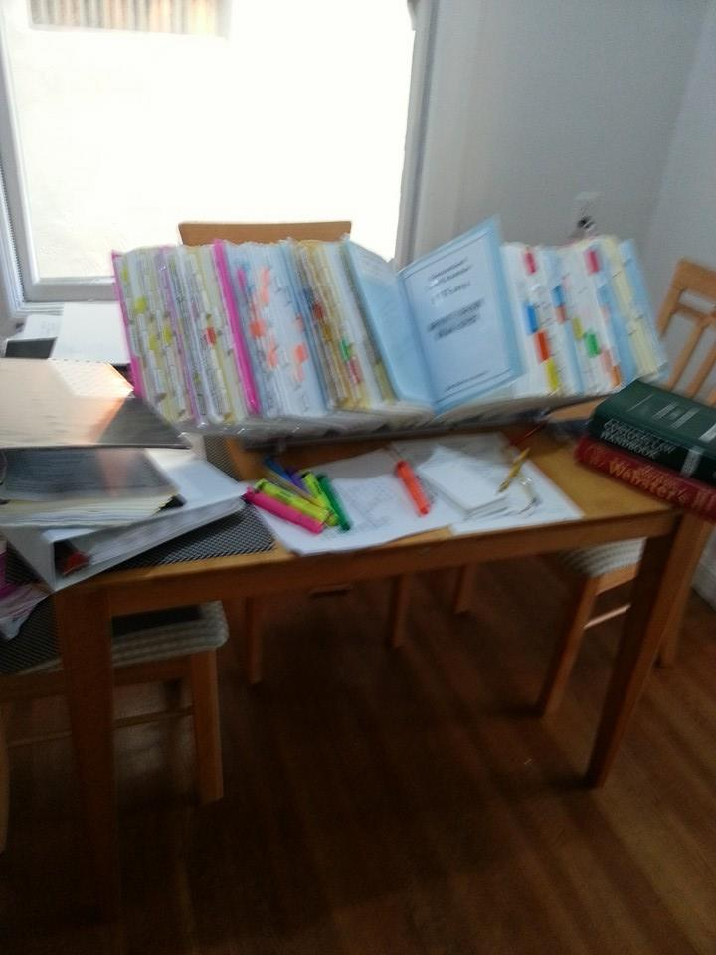

Slide 2
What is a Classification? Why is this Important?
10 digits
85
8542
8542.39
8542.39.00
8542.39.0000
Reasonable Care
Payment of duties and taxes
Identifies other Partnering Government Agencies (PGAs)

Slide 3
General Rules of Interpretation (GRIs)
There are 7 GRIs.
GRIs 1 through 4 used in order.
GRIs 5 and 6 always followed.
Additional U.S. Rules of Interpretation

Slide 4
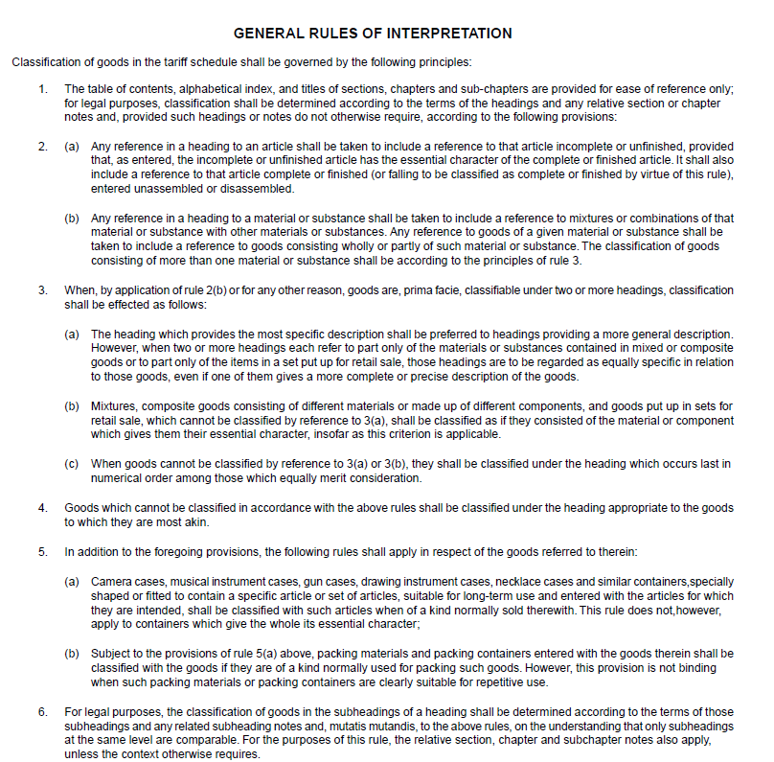
GRIs as written in the US Tariff

Slide 5
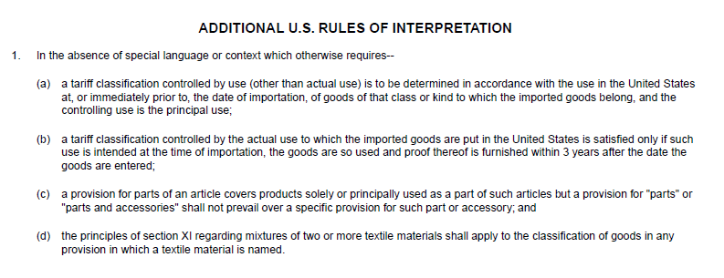
GRIs as written in the U.S. Tariff (cont.)

Slide 6
GRIs Explained
GRI 1- Eo nominee- specifically called out
GRI 2- Incomplete, unfished, disassembled
GRI 3- Mixtures
Most specific
Essential Character
Last in numerical order
GRI 4- Akin
GRI 5- Cases and containers
GRI 6- Heading to heading, subheading to subheading
Additional U.S. Rules of Interpretation- absence of special language or context

